Slide 1

H172 35 - Object Oriented Analysis and Design
Airline Booking System Activity Diagram Example

Slide 2
Airline Booking System Make Booking

Slide 3
Airline Booking System
Customers want to BOOK FLIGHTS
They Login (and can register account etc. as necessary)
Then they enter a destination and a date they’d like to fly
Then they select their preferred flight from the available options
They enter the passenger info of who is travelling
If they wish, they can add optional extras like insurance etc.
They pay for the flight
The system creates a booking record in the system and sends a confirmation email

Slide 4
Use Case Diagram

Slide 5
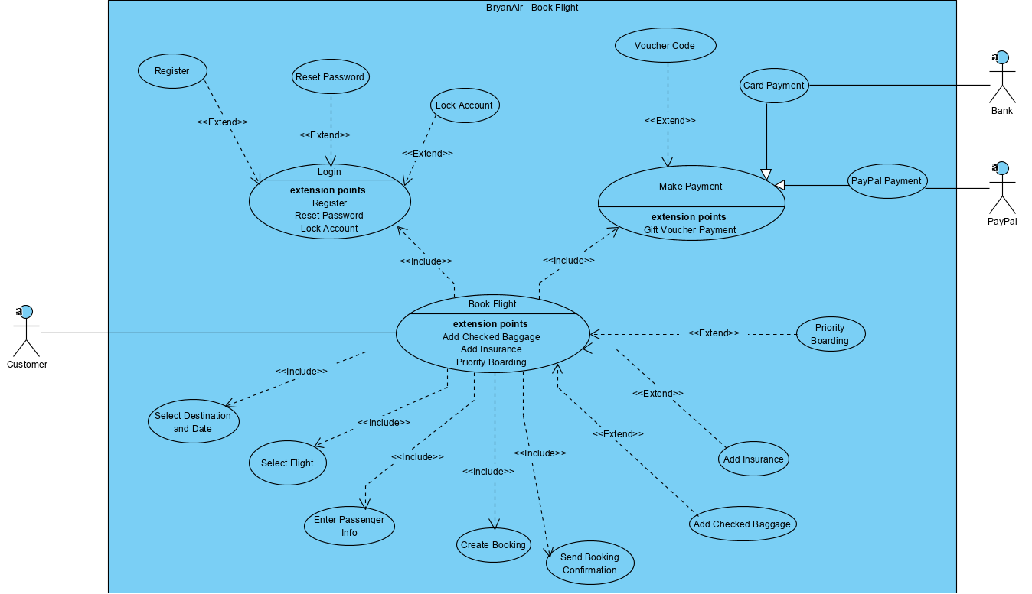

Slide 6
Activity Diagram

Slide 7
Login Section

Slide 8
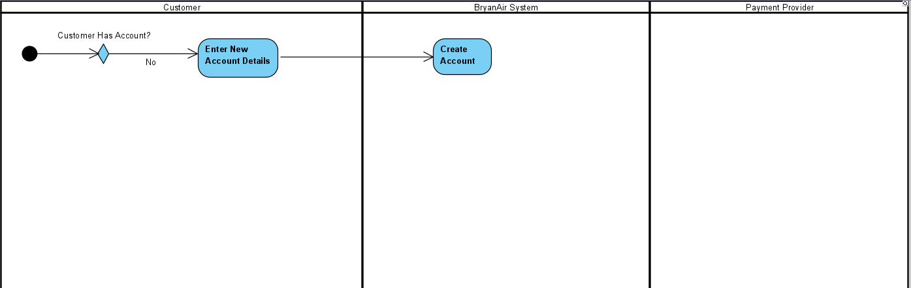

Slide 9
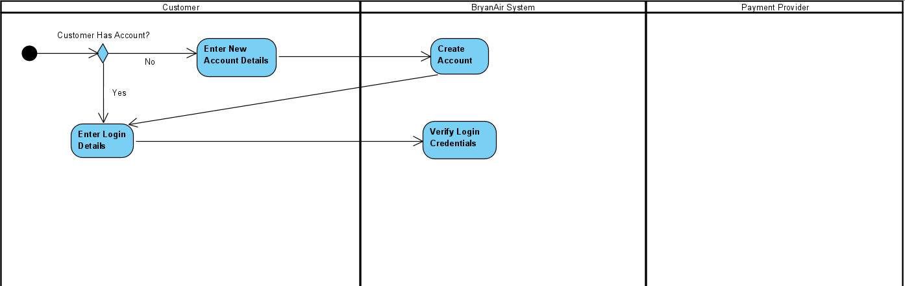

Slide 10
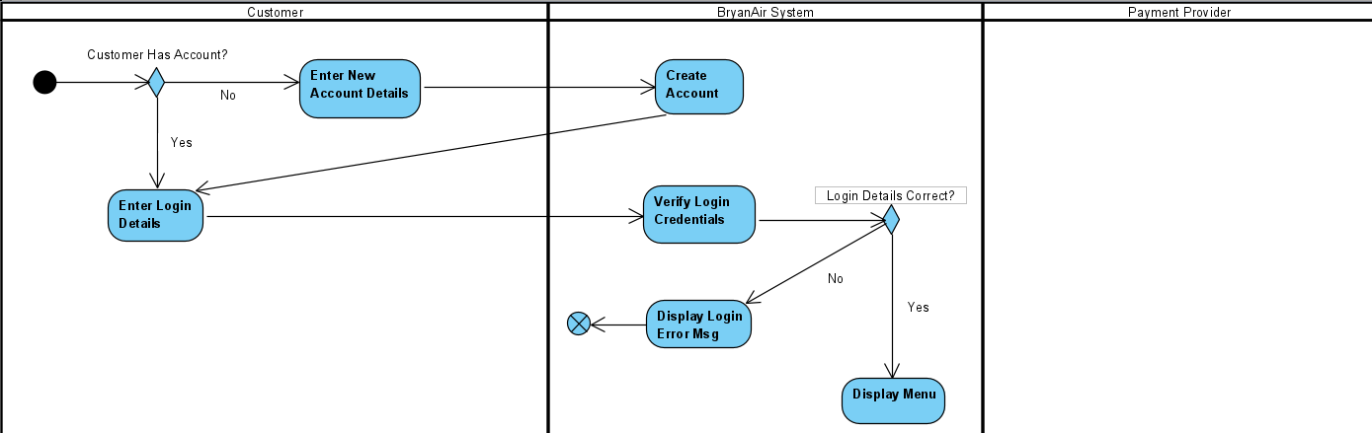

Slide 11
Search for + Select a Flight Section

Slide 12
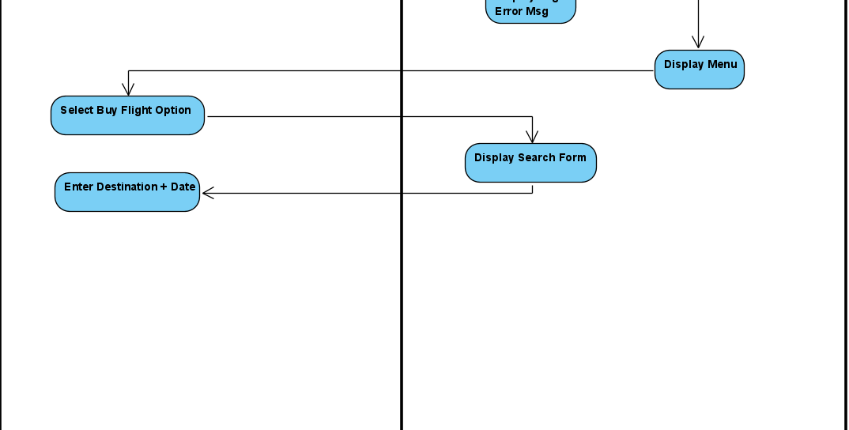

Slide 13
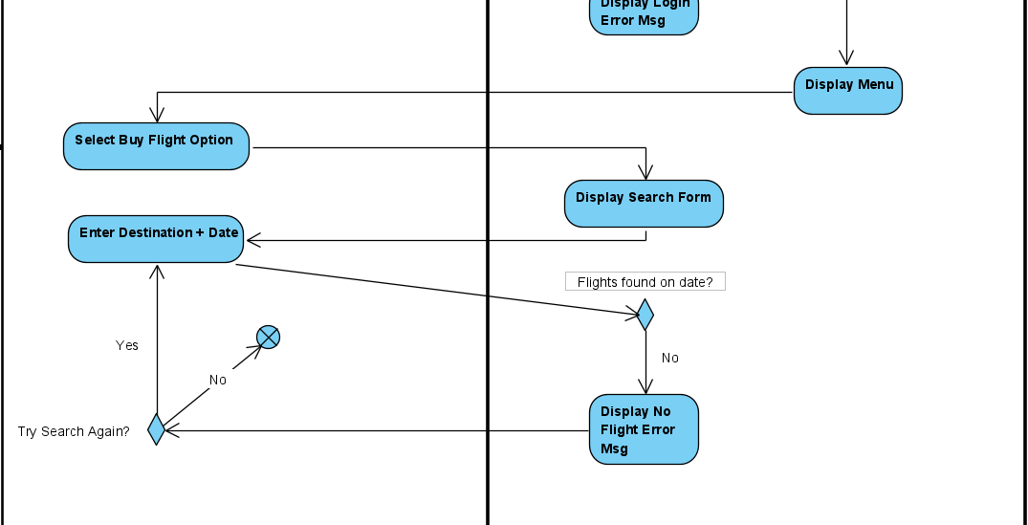

Slide 14
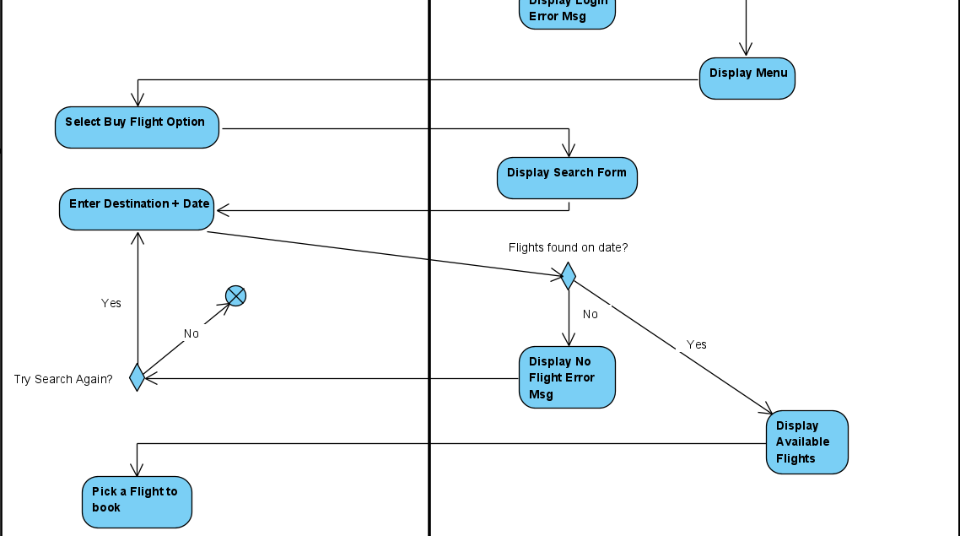

Slide 15
Add Optional Extras Section

Slide 16
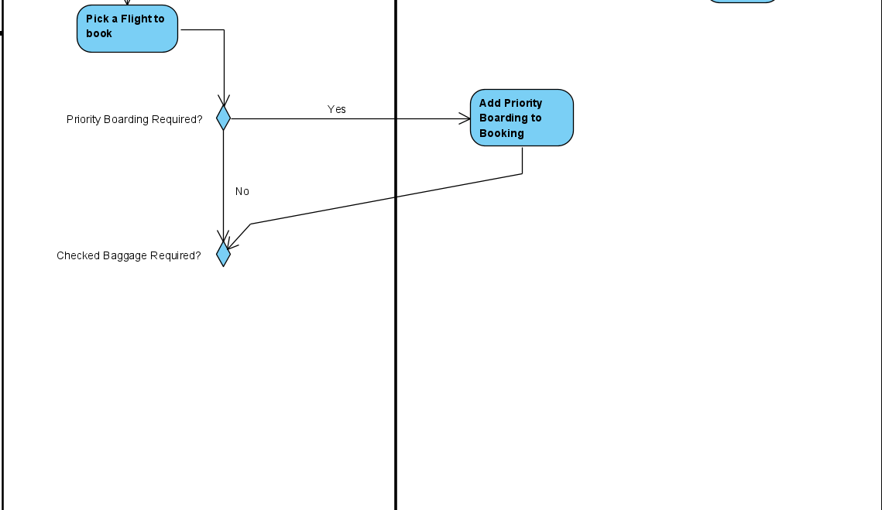

Slide 17
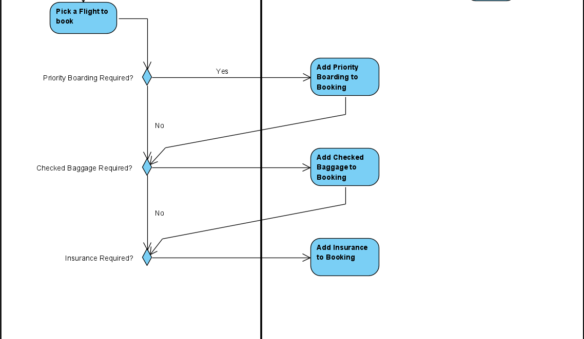

Slide 18
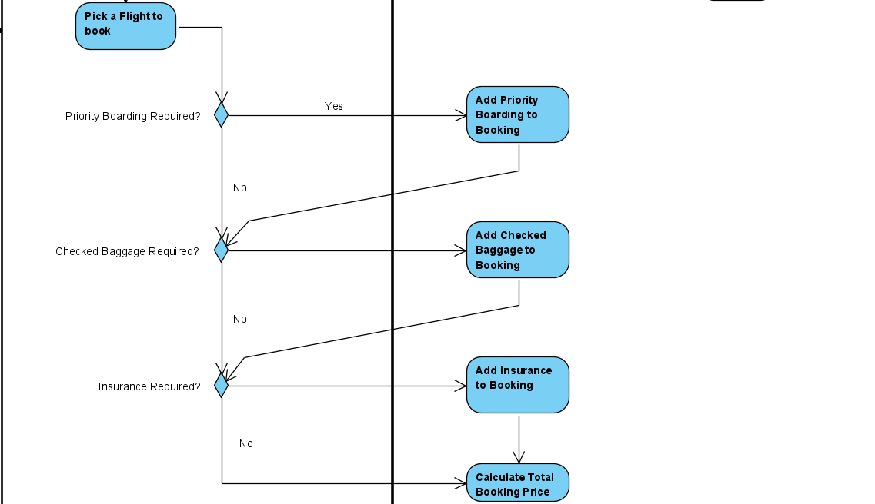

Slide 19
Payment + Confirm Booking Section

Slide 20
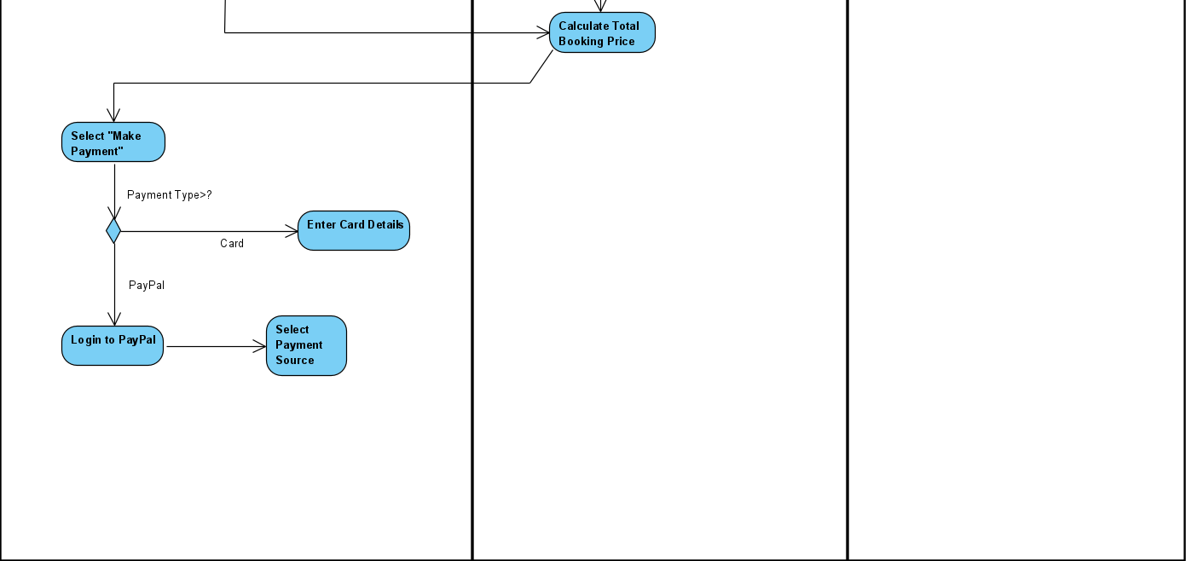

Slide 21
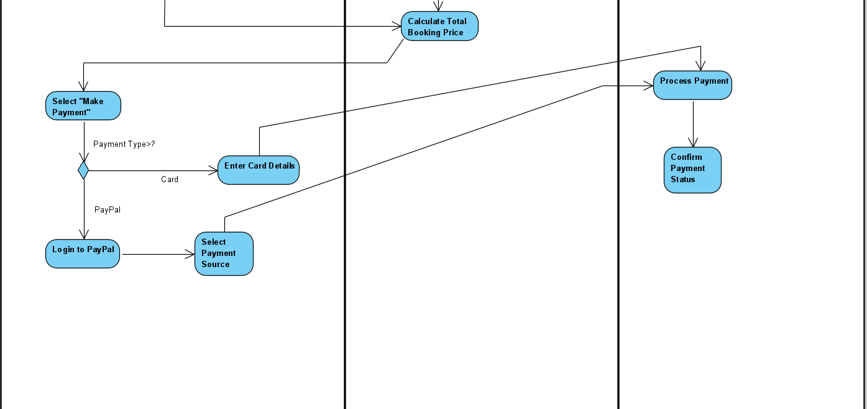

Slide 22
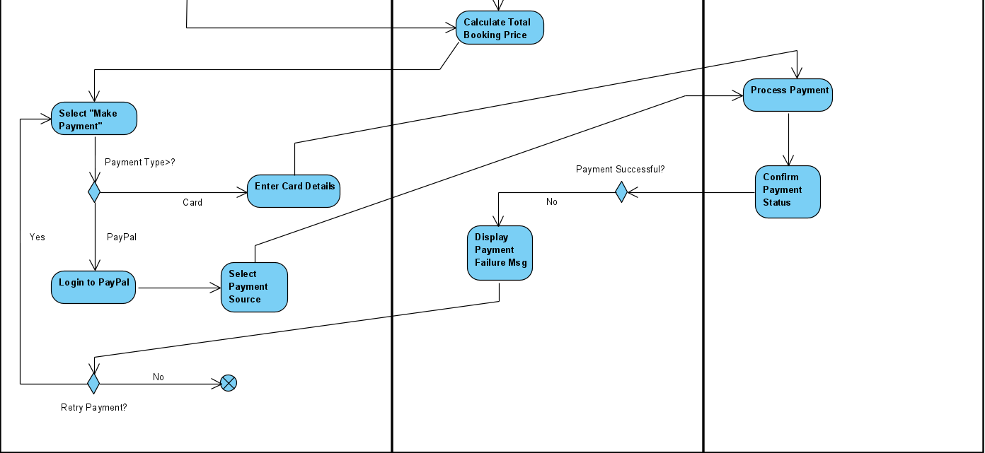

Slide 23
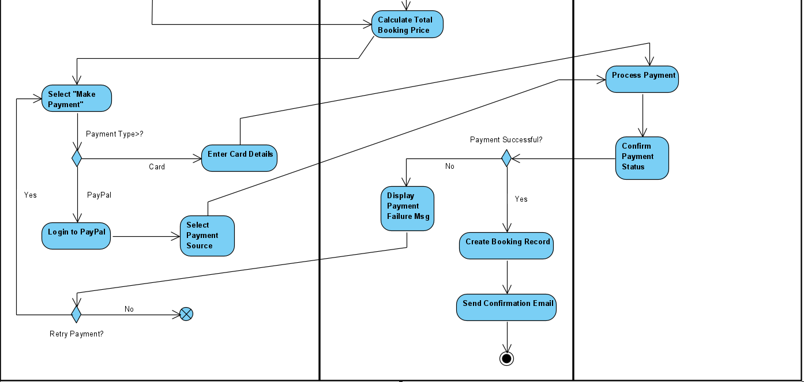

Slide 24
Full Diagram

